Slide 1
CS 668 Analytics Capstone Project
Pace University - New York
Instructor: Krishna, Bathula
By
Jagadesh Varma Nadimpalli

Slide 2
Vision Transformer and EfficientNetV2 for Skin Cancer Diagnosis

Slide 3
Vision Transformers and EfficientNetV2 for Skin Cancer Diagnosis

Slide 4
OVERVIEW
Problem Statement
Introduction
Background Research
Dataset
Visual Data Insights
Image Preprocessing
Methodological Approaches
Results
Key Takeaways & Future Scope
Works Cited

Slide 5

Hello Doctor!
SITA:
"I have something I’d like to discuss with you today regarding a spot on my skin that I'm concerned about."

Slide 6
PROBLEM STATEMENT
1

Slide 7
Early detection is critical for effective skin cancer treatment, yet current diagnostic methods are limited by their reliance on specialist availability and often involve invasive procedures. This project addresses the need for a more accessible, non-invasive, and accurate skin cancer diagnosis solution by leveraging advanced computer vision models such as Vision Transformer and EfficientNetV2. The goal is to improve early detection rates, reduce healthcare disparities, and streamline the diagnostic process for skin cancers globally.

Slide 8
INTRODUCTION
2

Slide 9
Skin cancer is the most widespread form of cancer in the U.S., affecting one in five Americans and resulting in over 9,500 daily diagnoses. Nonmelanoma skin cancers like basal cell carcinoma (BCC) are widespread, with millions affected annually. Meanwhile, melanoma, the most lethal type, affects over one million Americans, with rising incidence among the elderly and decreasing trends in individuals under 30. The economic burden of treating skin cancer exceeds $8 billion yearly, underscoring early detection's importance in dramatically improving survival rates. The HAM10000 dataset, vital for training diagnostic models, includes images of seven skin lesion types, ranging from benign growths like melanocytic nevi and dermatofibroma to aggressive melanomas and precancerous actinic keratoses, essential for developing accurate diagnostic tools.

Slide 10
BACKGROUND RESEARCH
3

Slide 11
TIMELINE
EfficientNet
SVM
AlexNet
VGG
ResNet
DenseNet
Vision Transformers
2006
FEB
2012
APR
2017
JUN
2018
AUG
2018
OCT
2021
DEC
2023

Slide 12
DATASET
4

Slide 13

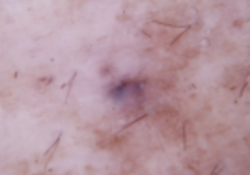
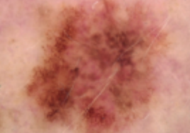
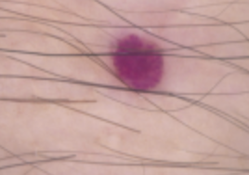
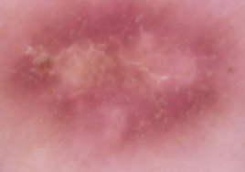
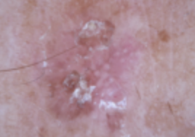
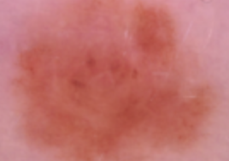
Skin Cancer Lesion Types
Benign Keratoses-Like Lesions
Basal Cell Carcinoma
Melanoma
Vascular Lesions
Dermatofibroma
Actinic Keratoses & Intraepithelial Carcinoma
Melanocytic Nevi

Slide 14
HAM10000 METADATA
Index | lesion_id | image_id | dx | dx_type | age | sex | localization | dataset
1878 | HAM_0000392 | ISIC_0034275 | mel | histo | 70 | male | trunk | vidir_modern
5376 | HAM 0005796 | ISIC_0030078 | nv | follow_up | 50 | female | upper extremity | vidir molemax
2744 | HAM_0003680 | ISIC_0024403 | bcc | histo | 65 | male | back | rosendahl
9988 | HAM_0001036 | ISIC_0027588 | akiec | histo | 50 | female | face | rosendahl
3063 | HAM-0002753 | ISIC_0026641 | nv | follow_up | 55 | male | lower extremity | vidir_molemax
402 | HAM_0001896 | ISIC_0030203 | bkl | histo | 50 | male | back | rosendahl
5727 | HAM_0007062 | ISIC_0029116 | nv | follow_up | 50 | female | trunk | vidir_molemax
7091 | HAM_0005213 | ISIC_0033998 | nv | histo | 30 | female | chest | vidir_modern
9186 | HAM 0005008 | ISIC_0030919 | nv | histo | 60 | male | lower extremity | rosendahl
51 | HAM 0007125 | ISIC_0025016 | bkl | histo | 75 | male | back | vidir_modern

Slide 15
VISUAL DATA INSIGHTS
5

Slide 16
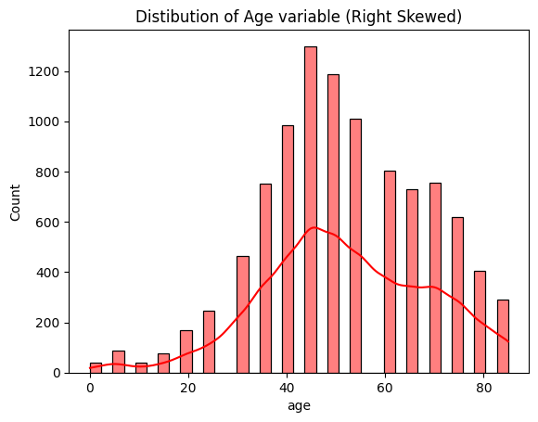
Distribution of Age over image count
COUNT
AGE

Slide 17
THE HAM10000 IMAGE DISTRIBUTION
MELANOCYTIC NEVI
6705
MELANOMA
1111
BENIGN KERATOSES-LIKE LESIONS
1099
BASAL CELL CARCINOMA
514
ACTINIC KERATOSES
327
VASCULAR LESIONS
142
DERMATOFIBROMA
115

Slide 18
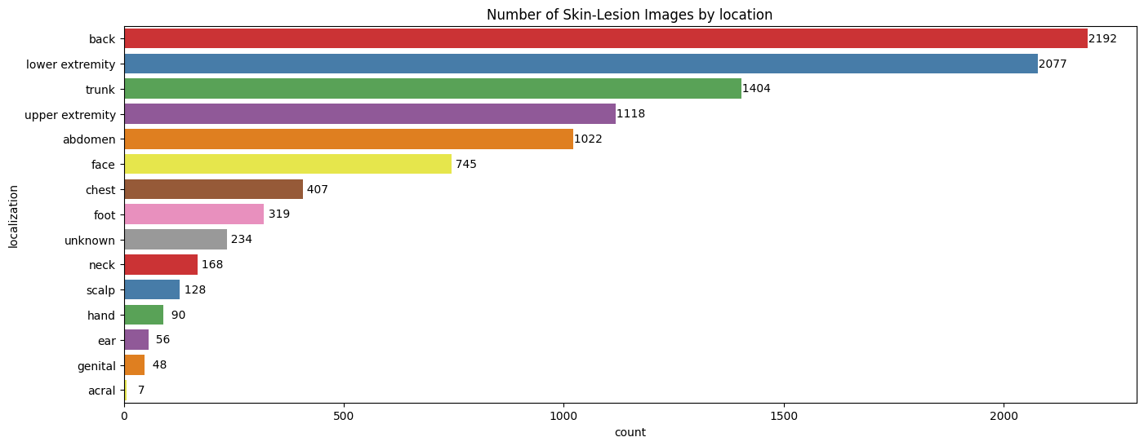
Skin Lesion Images by Location

Slide 19
IMAGE PREPROCESSING
6

Slide 20
Digital Hair Removal Algorithm
Convert Image to Grayscale
This simplifies the image by reducing it to a single luminance channel
Black Hat Morph Transform
A morphological kernel is created and used to reveal dark objects on a bright background.
Effectively "paints over" the areas where hairs were detected, using other pixel information to fill in the gaps.
Apply Inplanting
converts it to a binary image. Pixels with a value greater than 10 are set to 255 (w), and all others are set to 0 (bl)
Apply Binary Thresholding

Slide 21
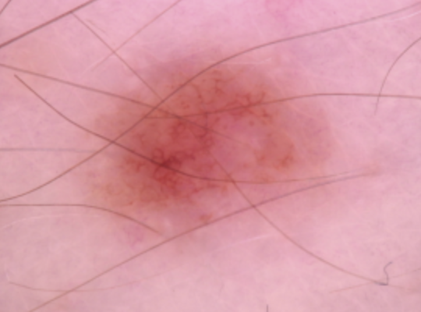
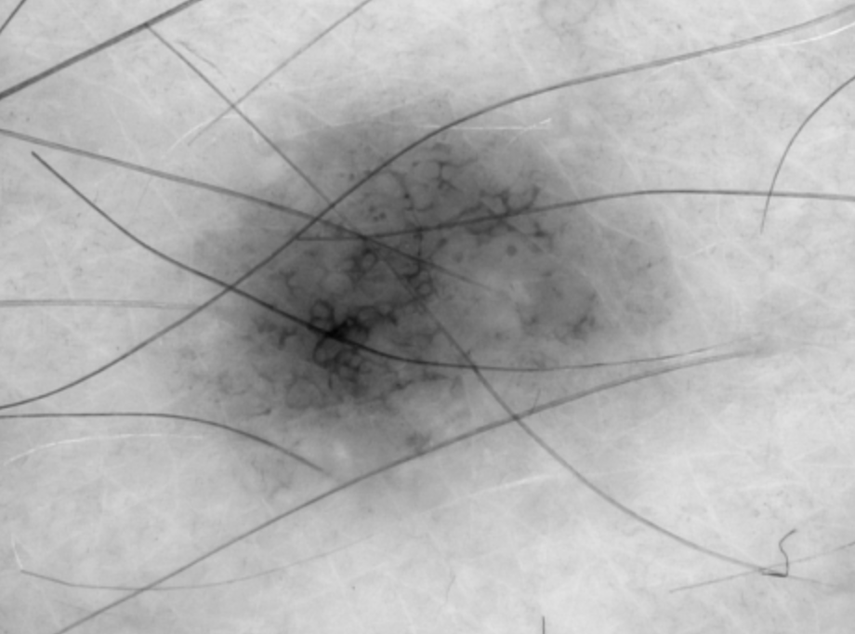
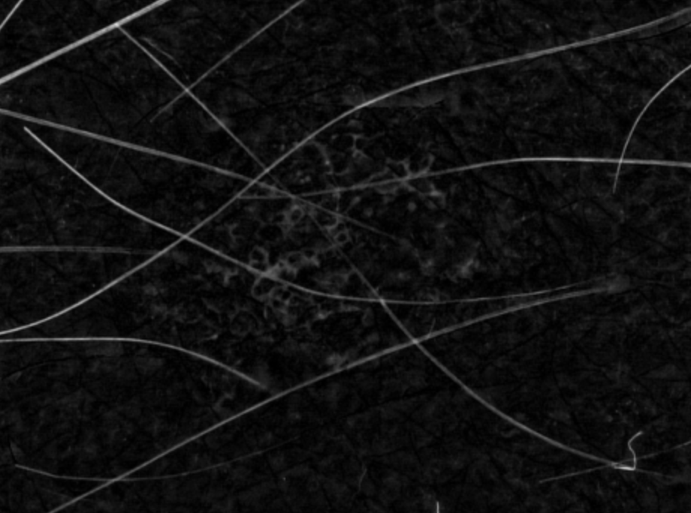
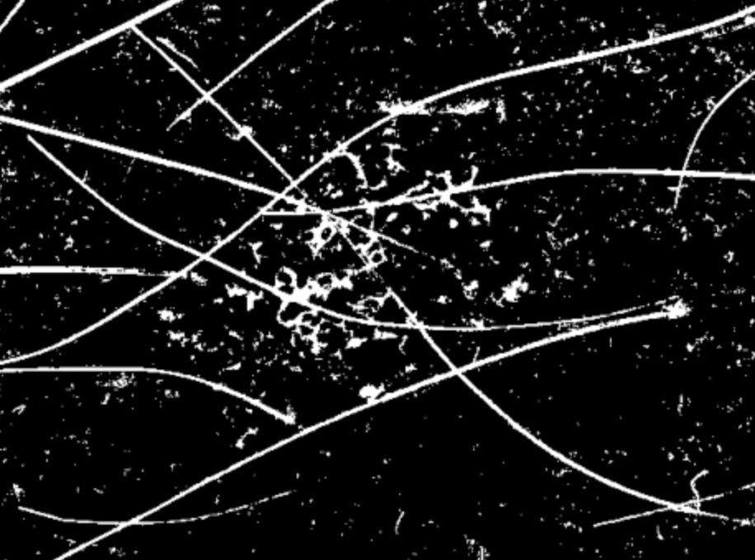
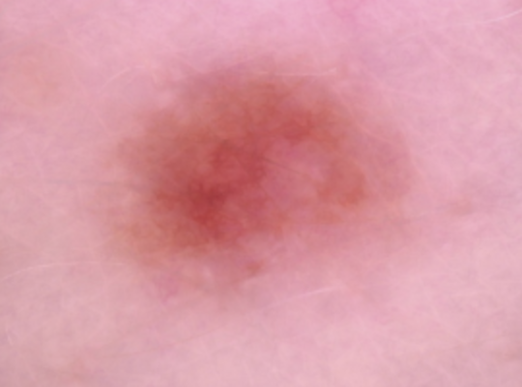
IMAGE COMPARISION

Slide 22
46,543
6,500+
(32 x 32)
IMAGE AGUMENTATION LEAD TO
Augmented Images
Images for each class
Resized Image Resolution

Slide 23
METHODOLOGICAL APPROACHES
7

Slide 24
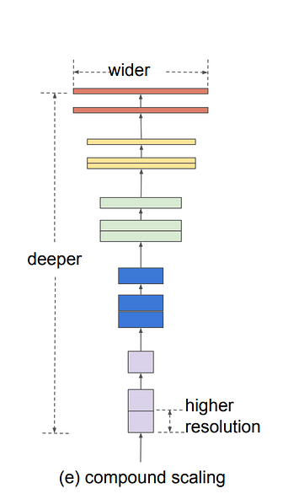
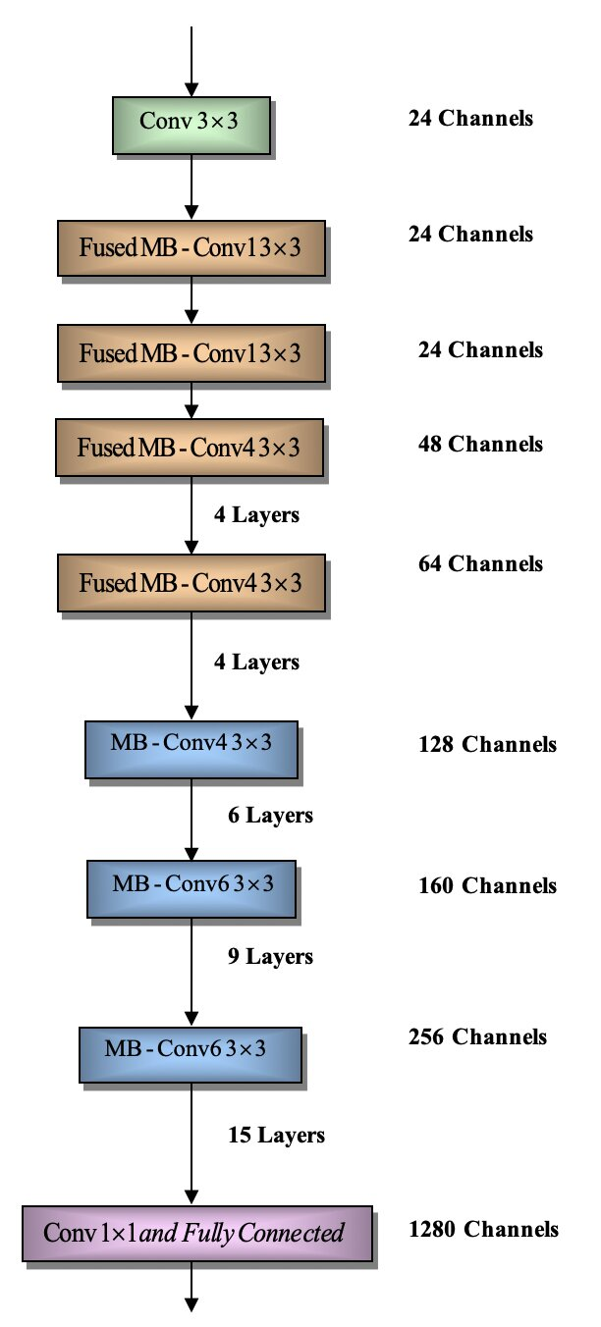
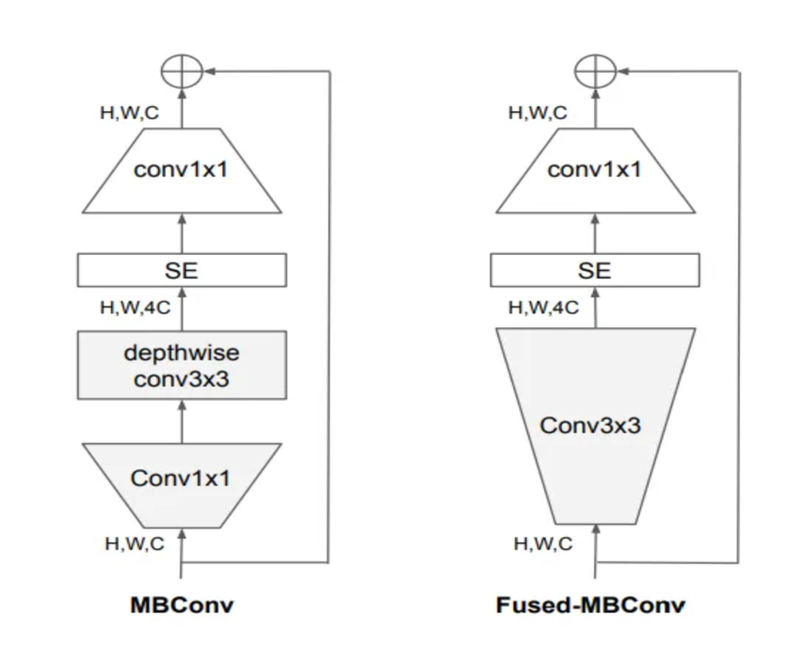
EfficientNetV2

Slide 25
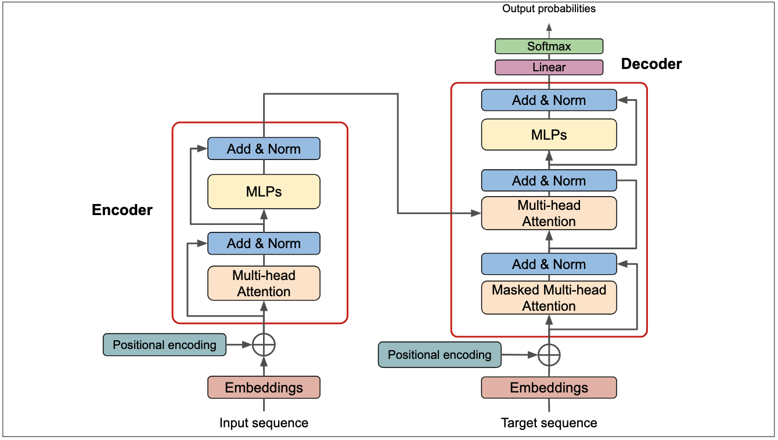
ViT 8x8 (Compact Vision Transformer)
Adapted the standard Vision Transformer architecture to better suit smaller 32x32 pixel images by developing the vit8x8 model, which utilizes smaller 8x8 pixel patches for more detailed feature extraction. This modified approach allows for enhanced resolution of attention within the compact image dimensions, starting with a custom Patches layer that precisely extracts these smaller patches, optimizing the model for datasets with limited image resolution.

Slide 26
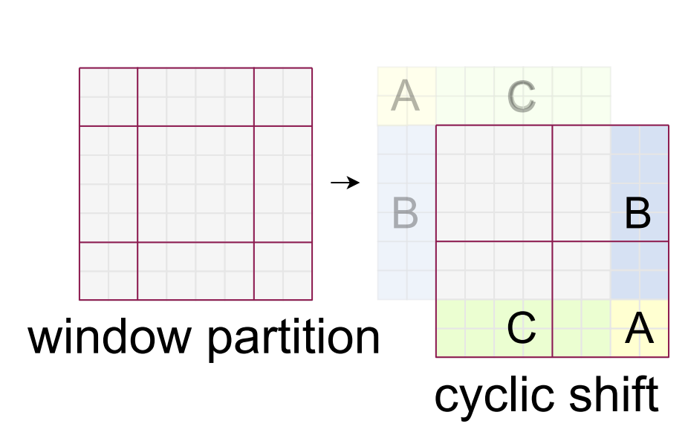
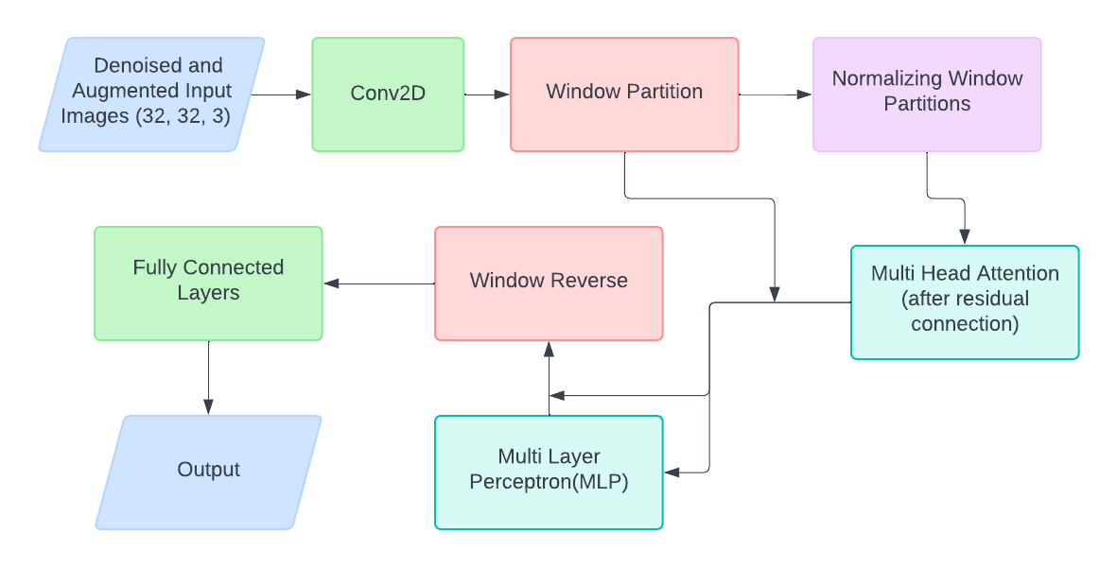
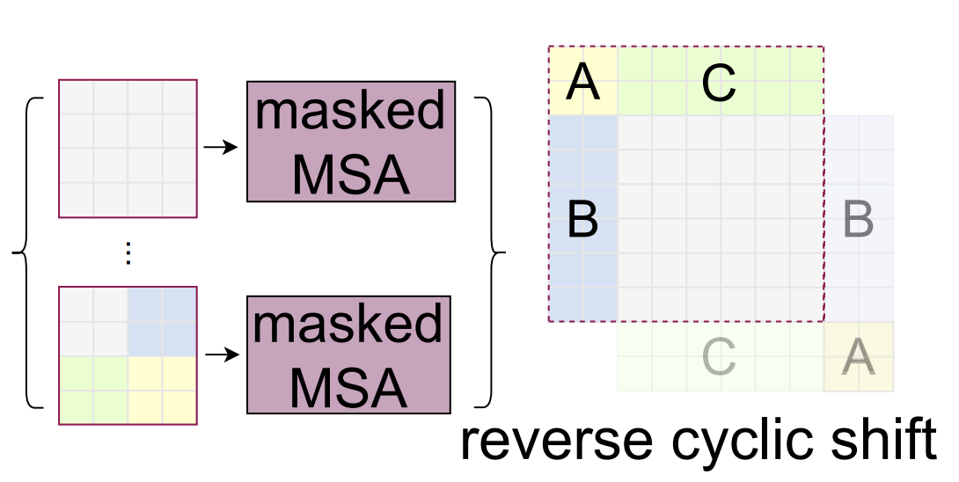
SWIN Transformer

Slide 27
RESULTS
8

Slide 28
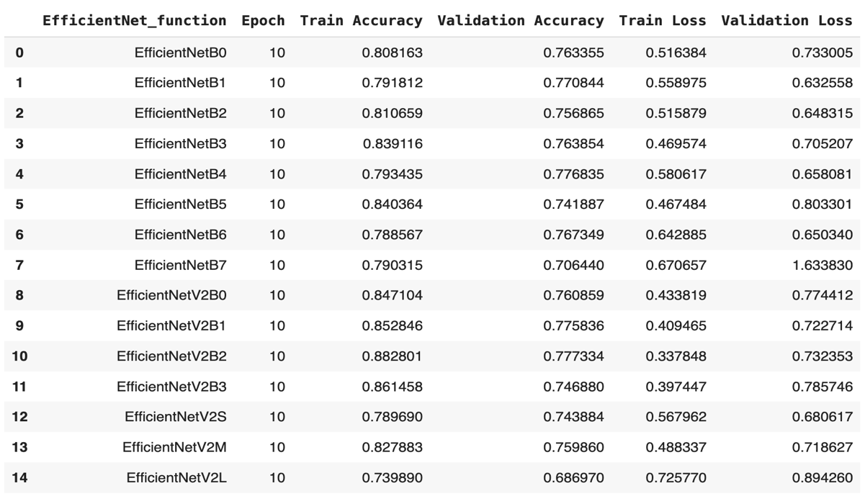
Training Session – 1 (EfficientNet) on Denoised Images

Slide 29
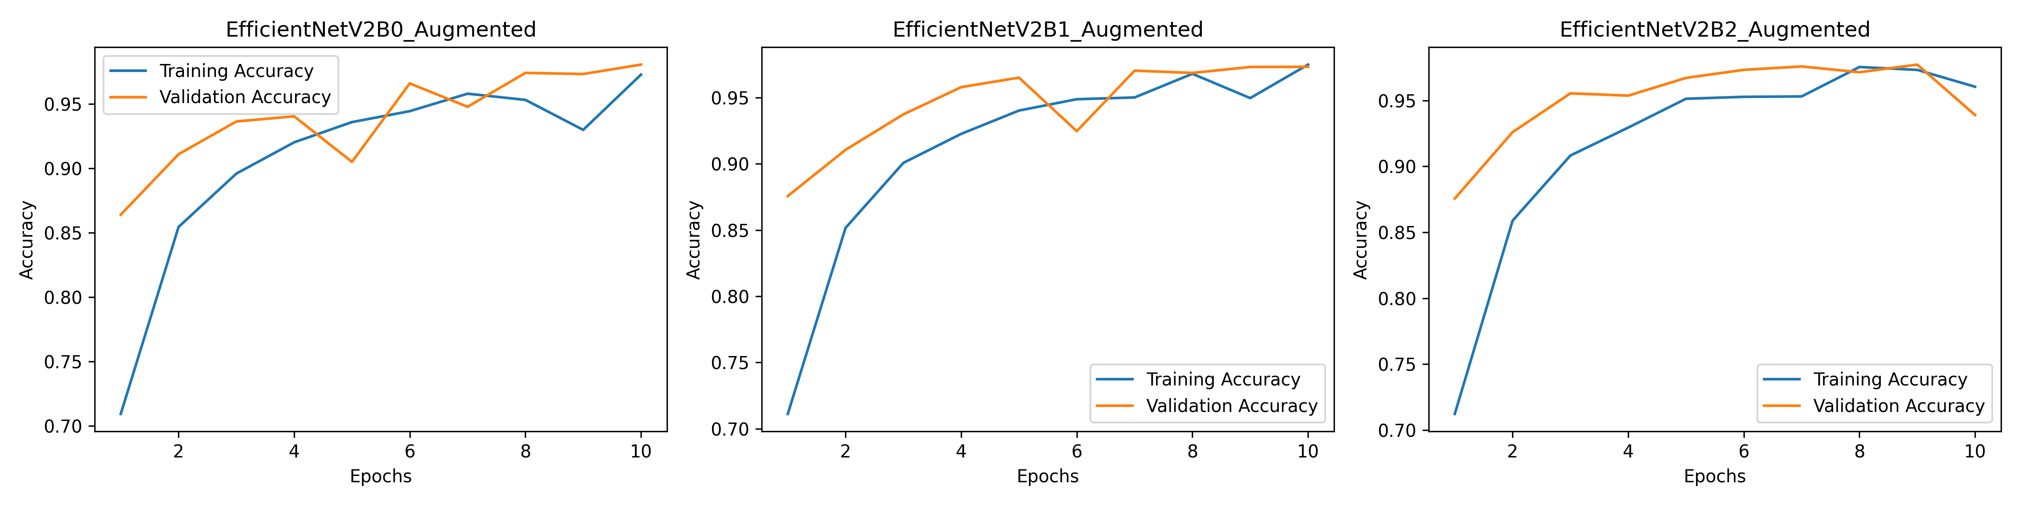
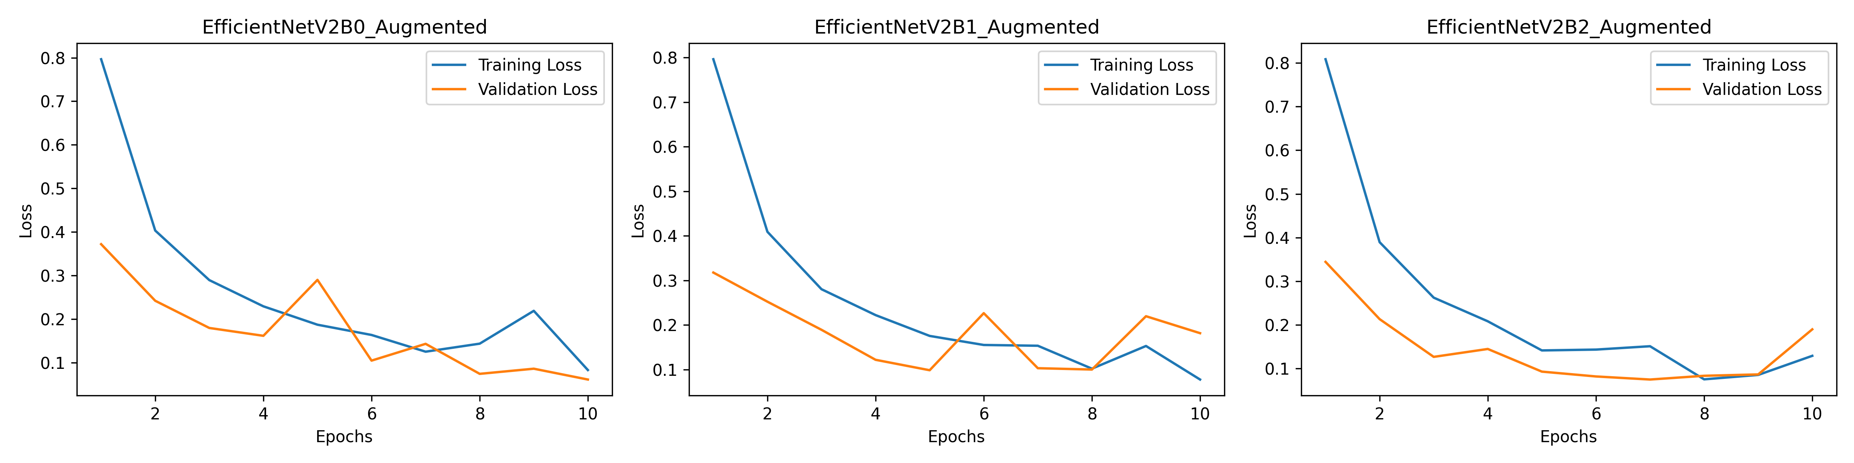
Training Session – 2 (EfficientNetV2) on Augmented Images

Slide 30
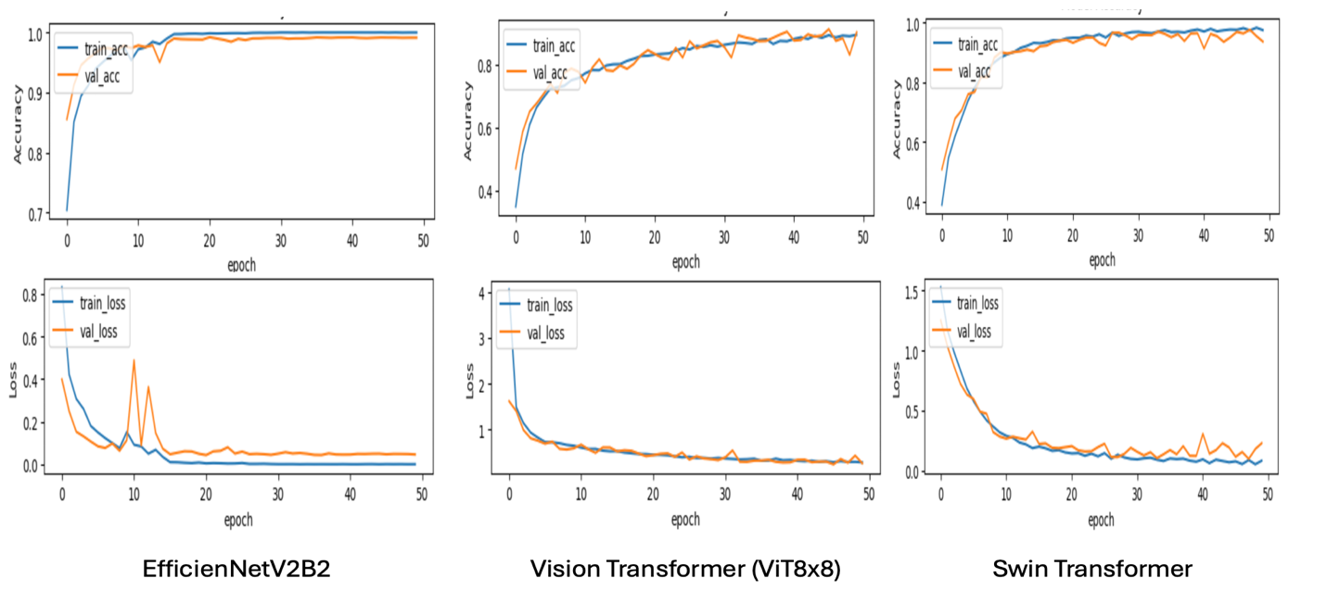
Training Session – 3 (EfficientNetV2, ViT8x8 & SWIN Transformer

Slide 31
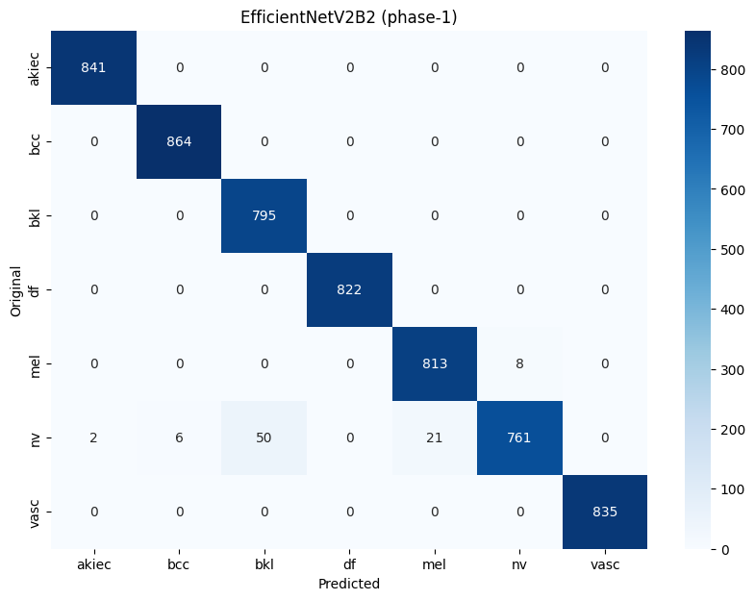
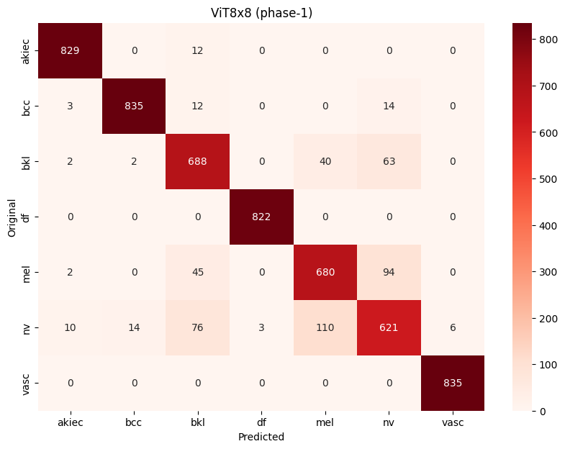
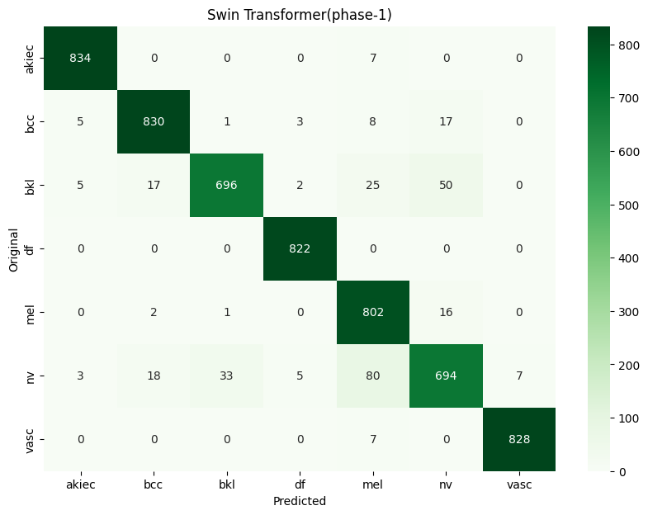
Testing Phase – 1 (Hold-Out Test Images)
98.5%
91.27%
94.64%
Accuracy Scores

Slide 32
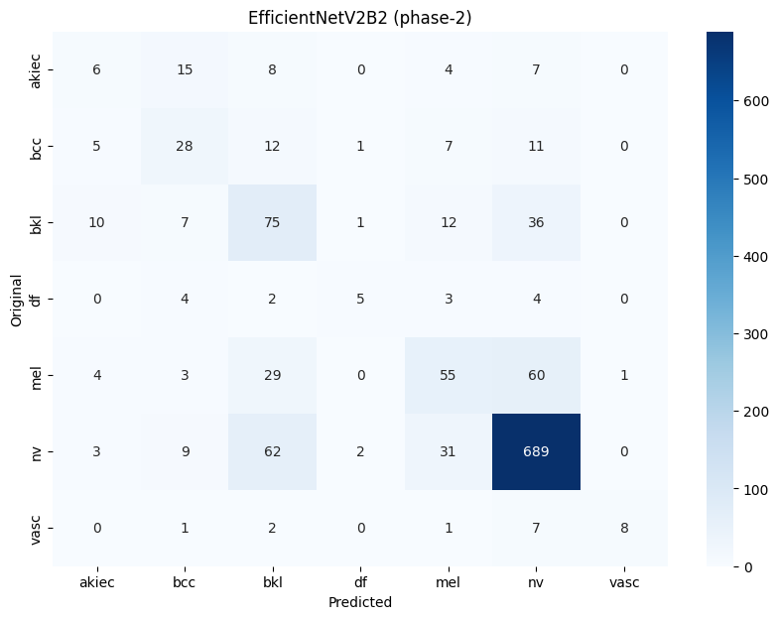
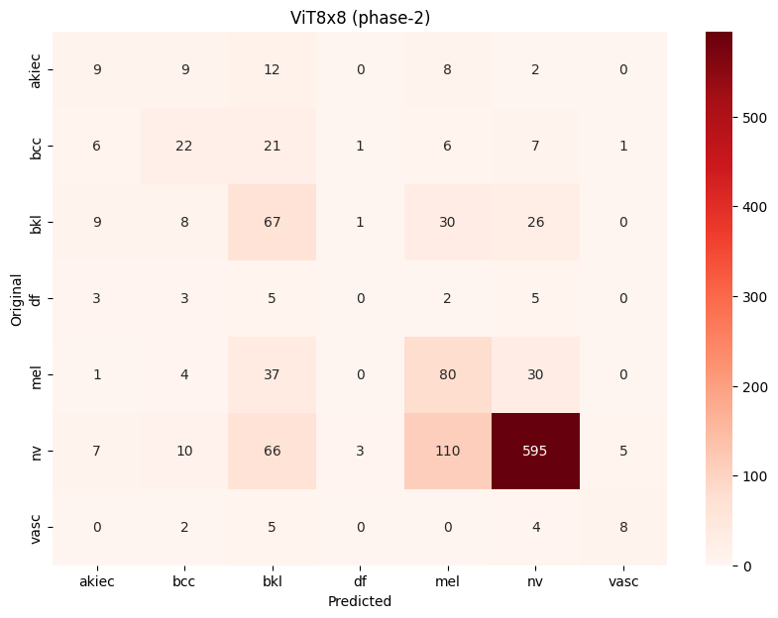
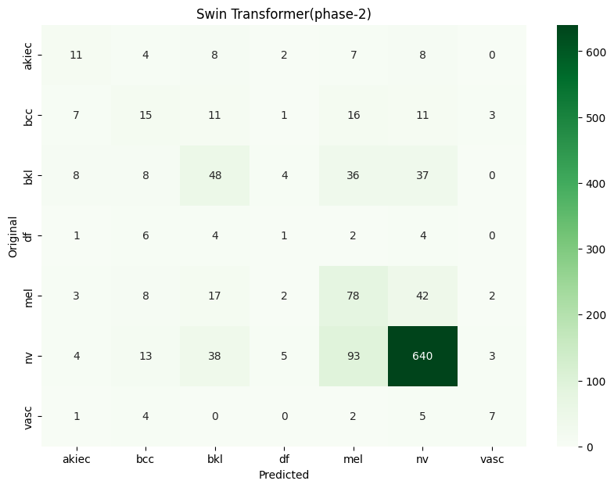
Testing Phase – 2 (External Test Images)
70.41%
63.5%
65.04%
Accuracy Scores

Slide 33
Phase - 1
Phase - 2
100
75
50
25
0
EfficientNetV2
ViT 8x8
SWIN Transformer
Bar Graph Representing testing phases accuracies

Slide 34
KEY TAKEAWAYS & FUTURE SCOPE
9

Slide 35
Digital Hair Removal Algorithm is applied to remove hairs and minor noise present in the images.
Image Augmentation is performed to improve generalization ability of models.
Pre-trained EfficientNetV2B2 model performs better than Vision Transformer (ViT 8x8) and SWIN Transformer.

Slide 36
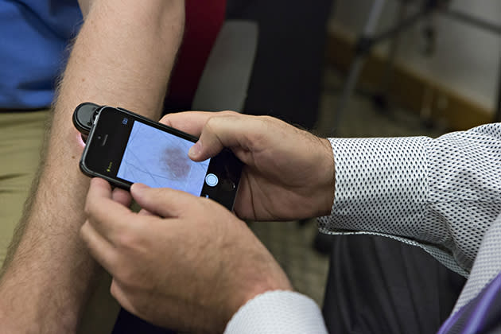
SAVE AND DEPLOY FOR REAL-TIME USE

Slide 37
WORKS CITED
10
1.American Academy of Dermatology. "Skin Cancer Statistics." American Academy of Dermatology, www.aad.org/media/stats-skin-cancer. Accessed 30 Apr. 2024.
2.Tan, Mingxing, and Quoc Le. "Efficientnet: Rethinking model scaling for convolutional neural networks." International conference on machine learning. PMLR, 2019.
3.Tan, M., and Q. V. Le. "Efficientnetv2: Smaller models and faster training. arXiv 2021." arXiv preprint arXiv:2104.00298.
4.Liu, Ze, et al. "Swin transformer: Hierarchical vision transformer using shifted windows." Proceedings of the IEEE/CVF international conference on computer vision. 2021.
5.Ghosh, Pronab, et al. "SkinNet-16: A deep learning approach to identify benign and malignant skin lesions." Frontiers in Oncology 12 (2022): 931141.
6.Belaala, Abir, et al. "Enhancing Dermoscopy-Based Skin Lesions Diagnosis: A Fusion of Convolutional Neural Networks and Self-Training." 2023 International Conference on Decision Aid Sciences and Applications (DASA). IEEE, 2023.
7.Latha, D. U., et al. "Skin Cancer Classification using ConvNET." 2023 International Conference on Recent Advances in Science and Engineering Technology (ICRASET). IEEE, 2023.
8.Hoshyar, Azadeh Noori, Adel Al-Jumaily, and Riza Sulaiman. "Review on automatic early skin cancer detection." 2011 International Conference on Computer Science and Service System (CSSS). IEEE, 2011.
9.Montaha, Sidratul, et al. "A shallow deep learning approach to classify skin cancer using down-scaling method to minimize time and space complexity." PloS one 17.8 (2022): e0269826.
10.Gessert, Nils, et al. "Skin lesion classification using CNNs with patch-based attention and diagnosis-guided loss weighting." IEEE Transactions on Biomedical Engineering 67.2 (2019): 495-503.
11.Khan, Muhammad Attique, et al. "Multi-model deep neural network based features extraction and optimal selection approach for skin lesion classification." 2019 international conference on computer and information sciences (ICCIS). IEEE, 2019.

Slide 38
THANKS!
ANY QUESTIONS?

Slide 39
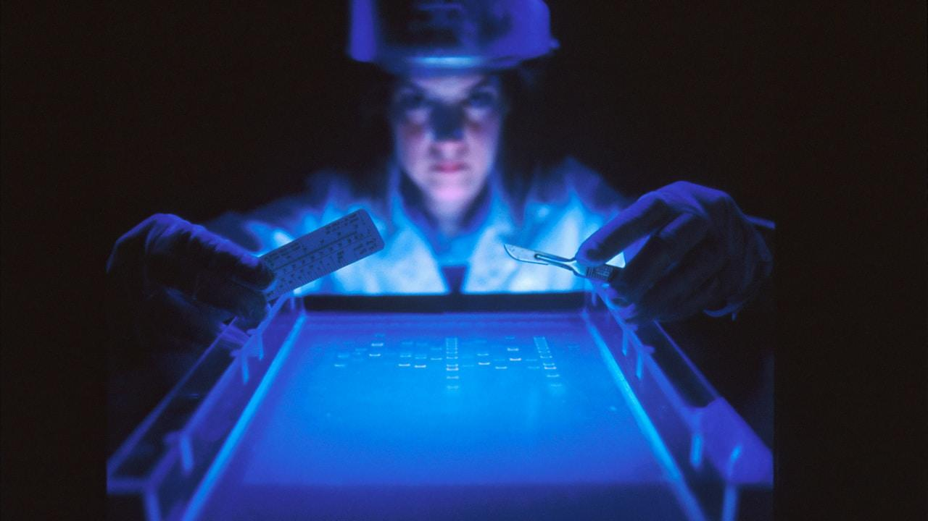
Oh! Lower Accuracy Score on External Images. What do you think is the reason?

Slide 40
Could you suggest future advancements in Computer Vision for medical datasets like HAM10000?

Slide 41
Alright! What about the Hardware Requirements, Memory size and Issues encountered by you?

